Slide 1
0x500 –Side Channel Attacks
ECED4406 – Computer Security
Dr. Colin O’Flynn
Dalhousie University.

Slide 2
What is a side channel attack?
INPUT
ENCRYPTION
OUTPUT

Slide 3

Classic Examples of Side Channels
Pizza Delivery during times of military operations
January 16 / 1991:
The pizza index indicates military action is imminent in the Persian Gulf, a Domino`s delivery official said Tuesday.
Record numbers of late-night pizzas have been delivered this week to the White House, Pentagon and State Department, said Frank Meeks, owner of several Washington-area Domino`s outlets.
Similar order patterns came immediately before the invasions of Panama and Grenada, Meeks said.
The increase in pizza orders at key government buildings after 10 p.m. is ''very unusual,'' Meeks said. ''I don`t think they`re sitting around watching Redskins reruns.''
https://www.chicagotribune.com/news/ct-xpm-1991-01-16-9101050225-story.html

Slide 4
Side Channels in Embedded Systems
Obvious:
Timing
RF (or electromagnetic emissions)
Power
Bus also:
Acoustic
Heat
..other measurable effects

Slide 5
Timing Side Channel
How would you compare a password?
int does_password_match(char * input_password)
{
good_password char[] = “hunter2”;
for(int i = 0; i < strlen(good_password); i++){
if (good_password[i] != input_password[i]){
return 0;
}
}
return 1;
}

Slide 6
How to find timing side channels?
Try various inputs to device, see if execution time is:
Constant with same input multiple times.
Different with different inputs multiple times.
We will look at something called T-Test which allow us to do statistical analysis later in this section.

Slide 7
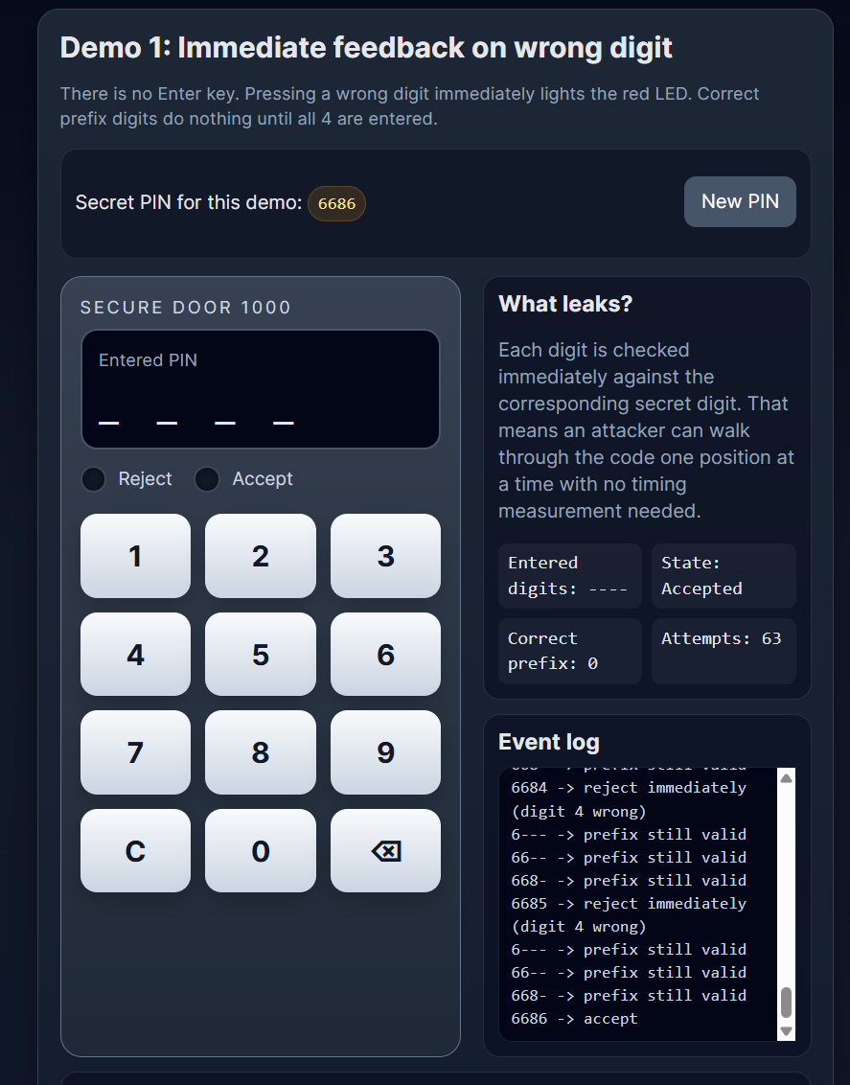
Timing Attack Demo – Part 1

Slide 8
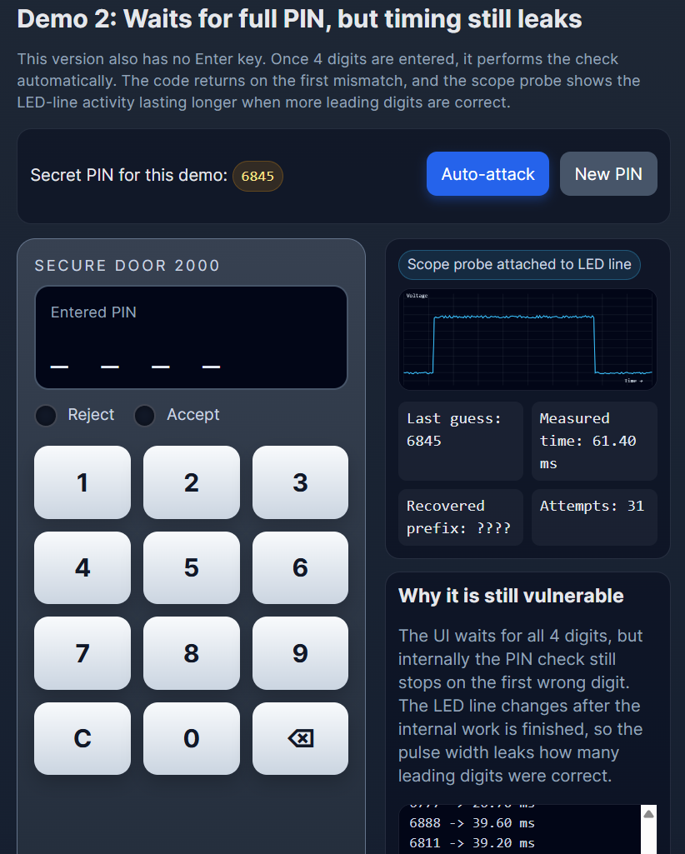
Timing Attack Demo – Part 2

Slide 9
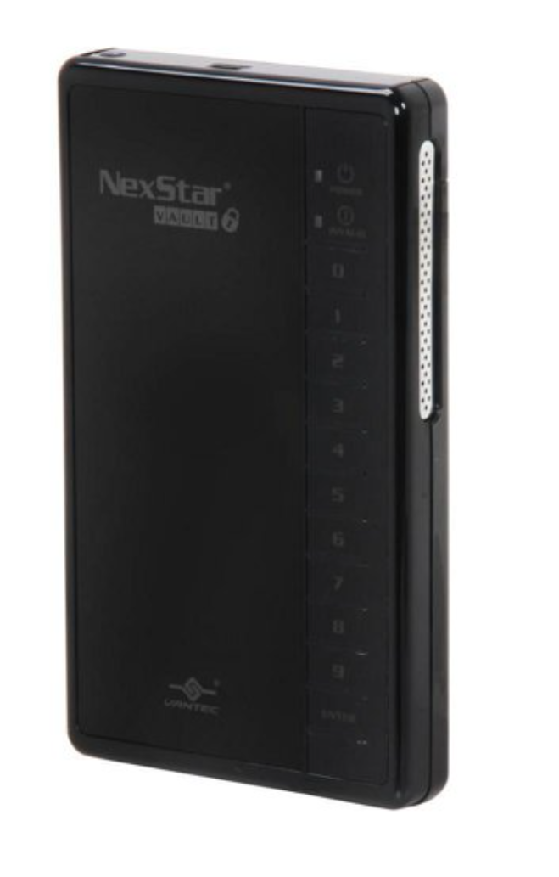
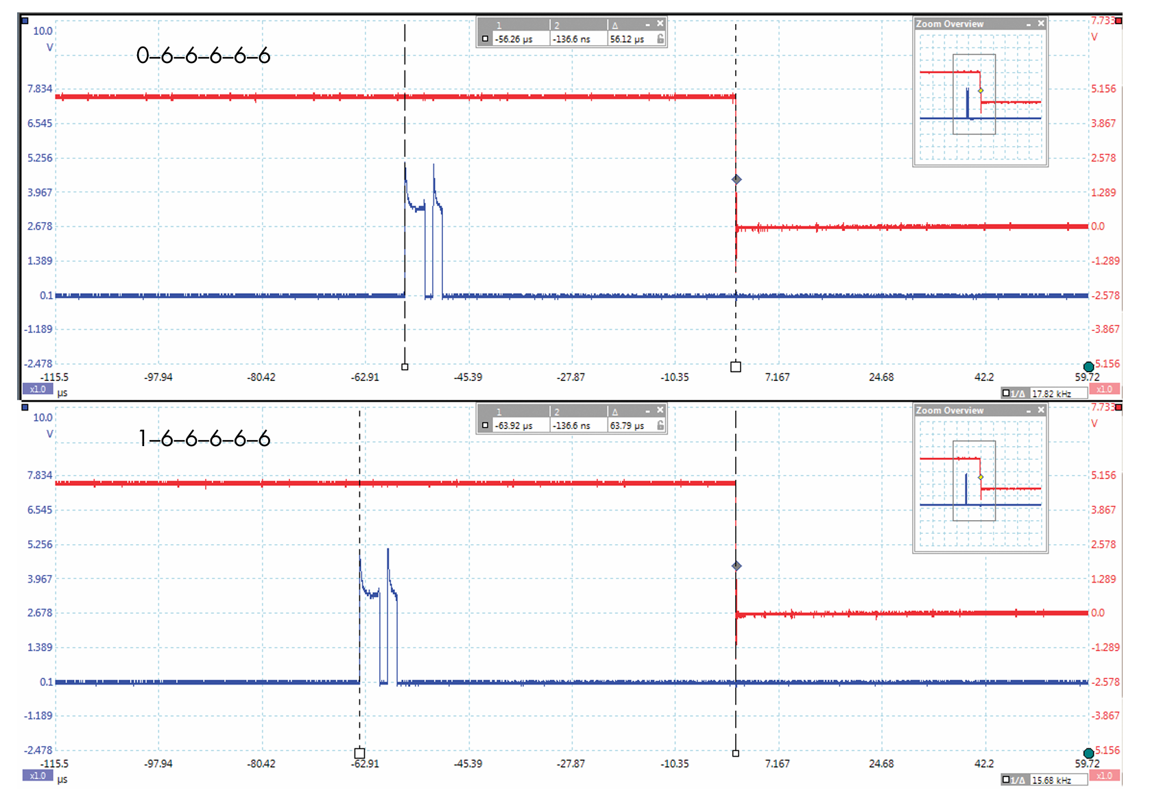
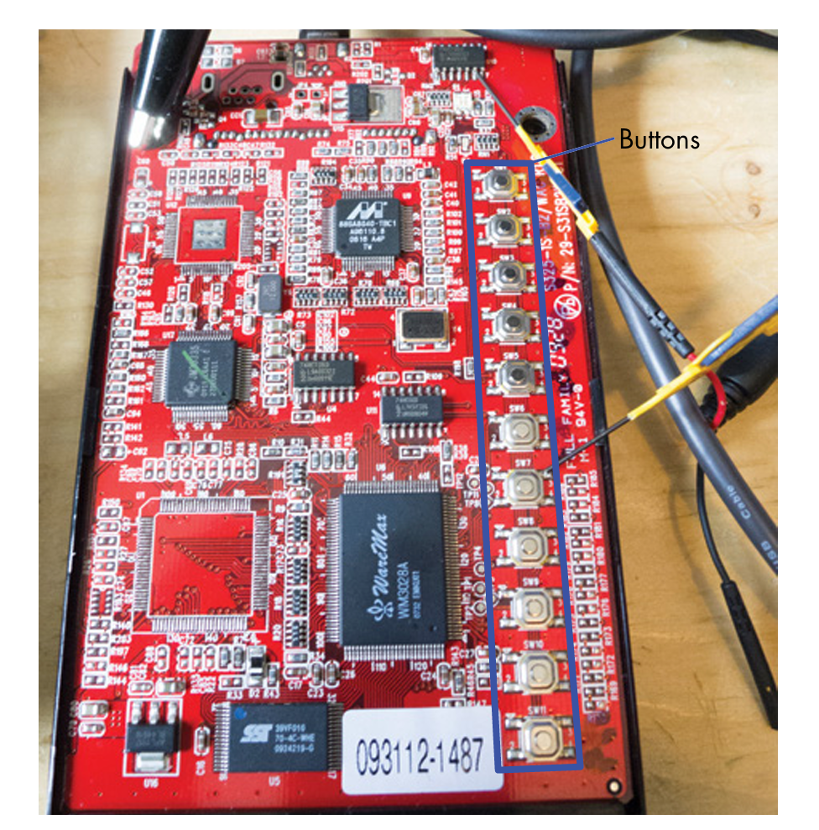
Real-Life Example

Slide 10
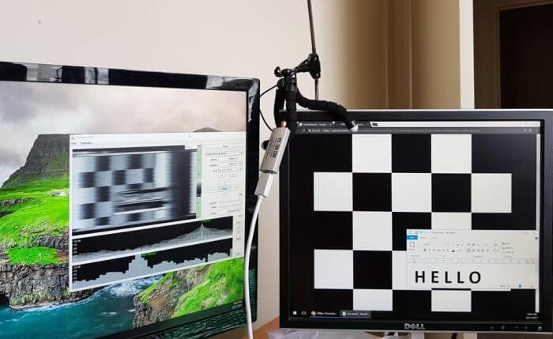
Early RF/EM Side Channels TEMPEST
During World War II, ability of devices to leak signals was discovered.
Early work also demonstrated can view computer monitors etc.
You can recreate this today too!
https://www.rtl-sdr.com/tempestsdr-a-sdr-tool-for-eavesdropping-on-computer-screens-via-unintentionally-radiated-rf/

Slide 11
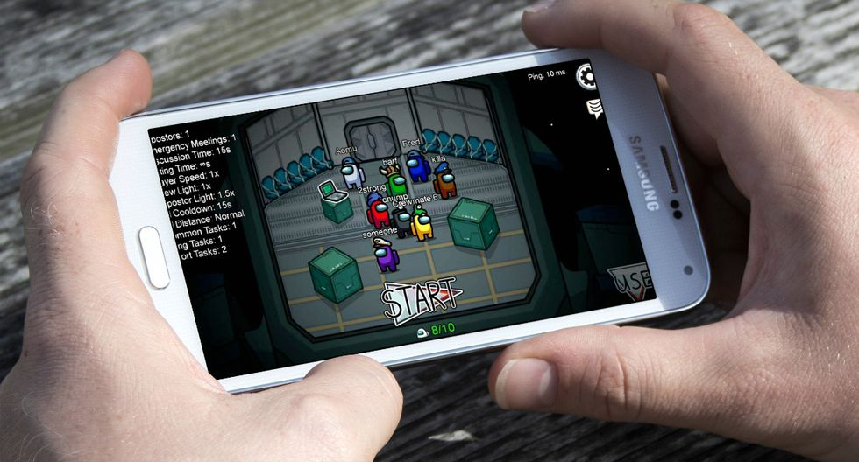
Power Side Channel
You might notice – power usage of your phone while playing a game much higher than while browsing the web.
It turns out – this works at a much faster rate than you expect!
Can tell for example:
Is device comparing password or done comparing?

Slide 12
More Reference on This - HHH
See Chapters 8 & Chapter 9 for more details on simple power analysis. Chapter 9 follows closely our Lab #4.
We’re going to cover Chapter 8/9/10 in this course if you want some reading week material.

Slide 13
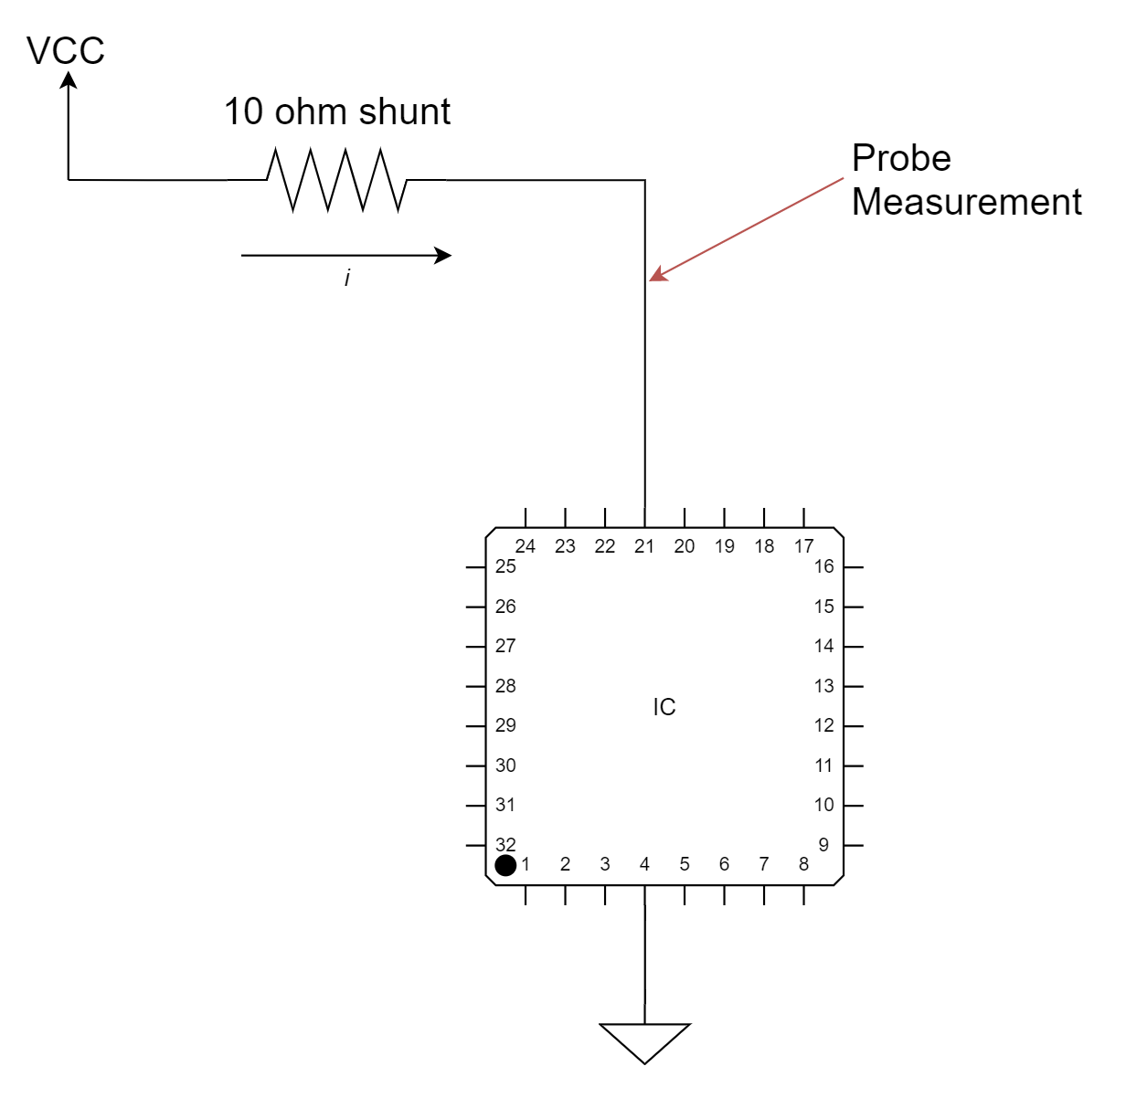
Resistive Shunt & Positive or Negative

Slide 14
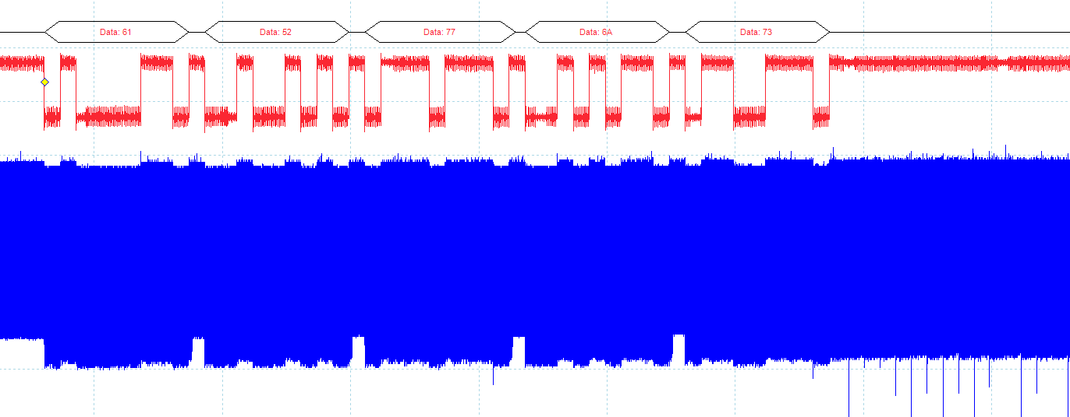
A Power Attack with Timing: Wrong Digit Immediately Noticable
Sending correct password (0x61 0x52 0x77 0x6A 0x73)

Slide 15
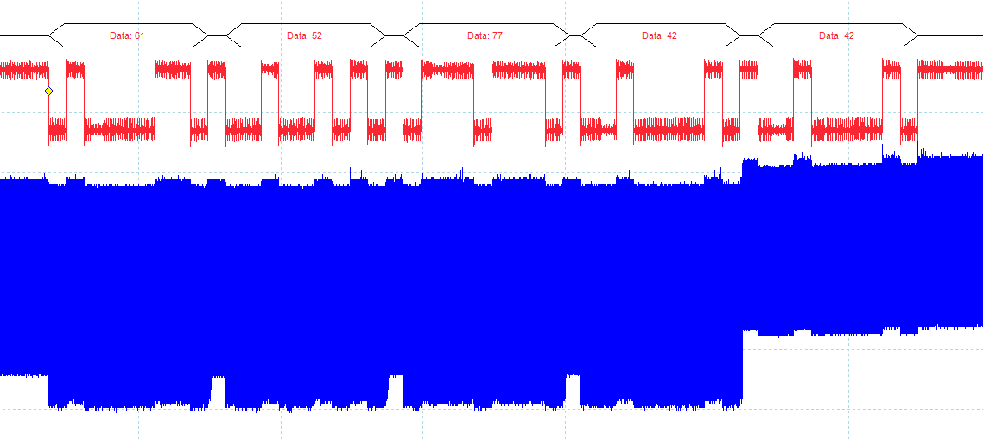
A Power Attack with Timing: Wrong Digit Immediately Noticable
Sending incorrect password (0x61 0x52 0x77 0x42 0x42)

Slide 16
A Power Attack with Timing: Wrong Digit Immediately Noticable
Sending incorrect password (0x61 0x52 0x77 0x42 0x42)

Slide 17
A Power Attack with Timing: Wrong Digit Immediately Noticable
Sending incorrect password (0x61 0x52 0x77 0x42 0x42)

Slide 18
A Power Attack with Timing: Wrong Digit Immediately Noticable
Sending incorrect password (0x61 0x52 0x77 0x42 0x42)

Slide 19
A Power Attack with Timing: Wrong Digit Immediately Noticable
Sending incorrect password (0x61 0x52 0x77 0x42 0x42)

Slide 20
A Power Attack with Timing: Wrong Digit Immediately Noticable
Sending incorrect password (0x61 0x52 0x77 0x42 0x42)

Slide 21
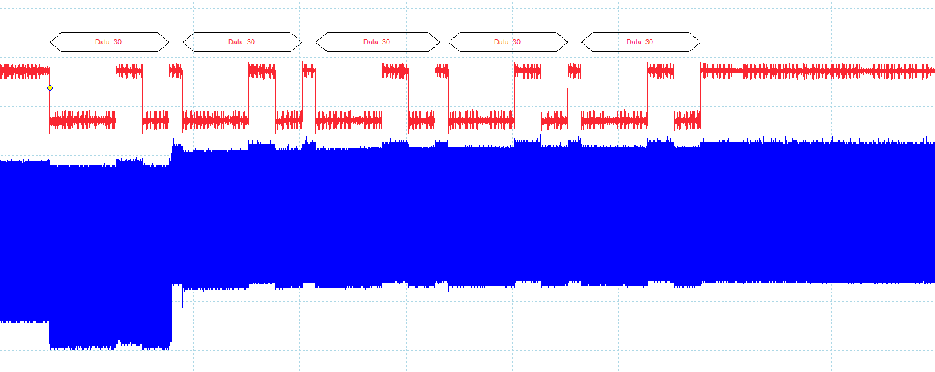
A Power Attack with Timing: Wrong Digit Immediately Noticable
Sending incorrect password (0x30 0x30 0x30 0x30 0x30)

Slide 22
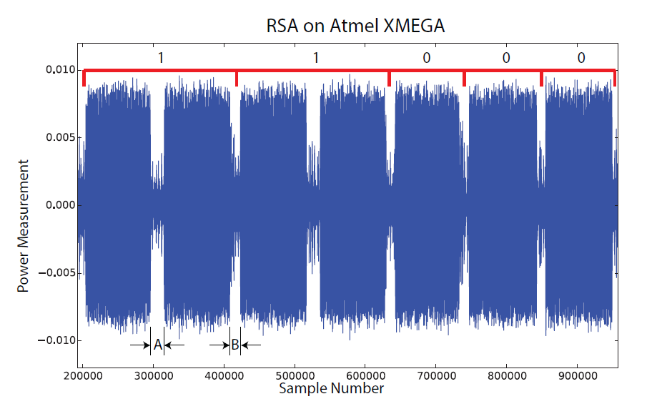
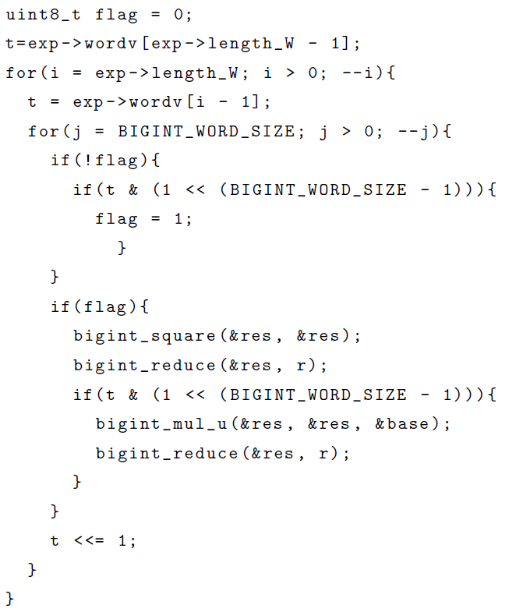
Instruction Leak → Data Leak

Slide 23
Summary
Side channels are “unintended” emissions of information.
We can observe this side channels to recover secret information from the device.

